Slide 1
SOA Management

Slide 2
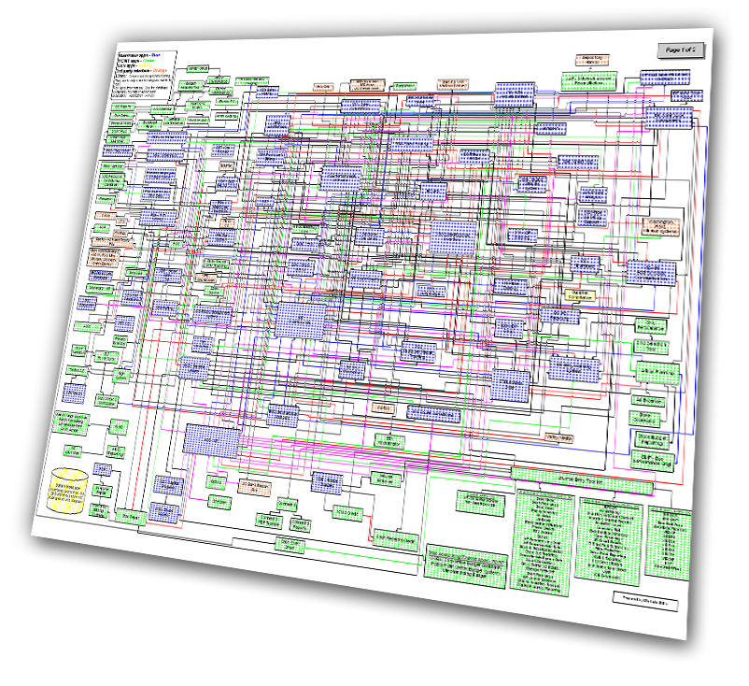
Current State of IT Management
More than 70% of IT budgets are currently devoted to the maintenance and operations of existing applications and systems.
The Yankee Group, 3/05

Slide 3


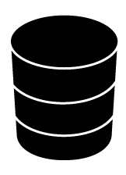
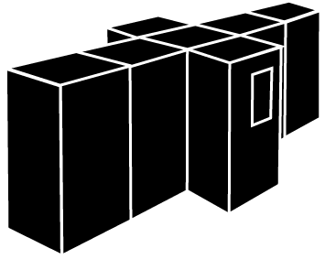


Managing Cost and Responsiveness Across IT Silos Composite Applications Introduce Management Challenges
Desktop Experts and Tools
Network
Experts and Tools
Application Experts and Tools
Database
Experts and Tools
Server Experts and Tools
Mainframe Experts and Tools
Storage Experts and Tools
Availability Management
Change Management
Service Level Management
www
Security Management
Labor Cost
Information Lifecycle Management
Release Management
Sense
Isolate
Diagnose
Take
Action
Evaluate
Time
Existing State
Desired State Through Process Automation
Notes:
The evolution in IT management has led to resource-oriented silos such as database experts and tools, and network experts and tools.
This leads to inconsistencies and duplication of processes … and results in increased labor costs.
Customers need to build on top of the resource management assets to develop horizontal repeatable process-oriented solutions that can achieve higher levels of efficiencies in their organizations.
This DOES NOT MEAN reducing headcount. It means doing more with the same.
Today, technical silos of expertise are not effective in managing a composite application infrastructure.
Application visualization is provided by front-end Web servers, new business logic is being deployed on a new infrastructure of applications servers and these have been integrated with legacy systems and applications. The composite application infrastructure is going to get more complex with the implementation of service oriented architectures.
Today most application interruptions or performance problems are reported to IT by end users of the business service. The challenge remains the same to provide the right information, to the right people at the right time so they can take an action but how that information is moved across the silos of technical expertise within IT is going to change.
What is needed today is a platform that will integrate the core process by which IT operates. These integrated processes will serve as the new platform for IT Service Management, reducing the labor cost associated with managing IT Services and increasing the effectiveness of IT operations.
The potential benefits are huge. Approximately $600B is spent on IT "In House Labor" and more than 80% is allocated just to keep IT up and running. Just imagine the amount of savings if IT can only gain 10% productivity in the execution of their internal processes.

Slide 4
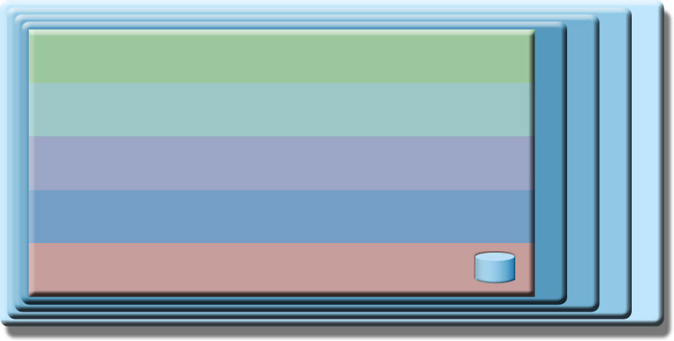

Requirements for SOA Management
Channel
B2B
Consumers
Service Consumer
Business Process
Composition; choreography;
business state machines
QoS Layer (Security, Management &
Monitoring Infrastructure Services)
Data Architecture (meta-data) &
Business Intelligence
Integration (Enterprise Service Bus)
Governance
Services
atomic and composite
Service Components
Service Provider
Operational Systems
Packaged
Application
Custom
Application
OO
Application
Atomic Service
Composite Service
Registry
Notes:
The second management area that we will discuss is managing Service Relationships, which includes:
Understanding how services relate to each other and to the IT infrastructure and business process layers
Controlling the message flow in the service environment through management mediations like log, filter, and route
Centralizing services management policy
Setting business-related IT goals

Slide 5
Requirements for SOA Management
Business Process Monitoring: Monitor state of business processes
Channel
B2B
Consumers
Service Consumer
Business Process
Composition; choreography;
business state machines
QoS Layer (Security, Management &
Monitoring Infrastructure Services)
Data Architecture (meta-data) &
Business Intelligence
Integration (Enterprise Service Bus)
Governance
Services
atomic and composite
Service Components
Service Provider
Operational Systems
Packaged
Application
Custom
Application
OO
Application
Atomic Service
Composite Service
Registry
Notes:
The second management area that we will discuss is managing Service Relationships, which includes:
Understanding how services relate to each other and to the IT infrastructure and business process layers
Controlling the message flow in the service environment through management mediations like log, filter, and route
Centralizing services management policy
Setting business-related IT goals

Slide 6
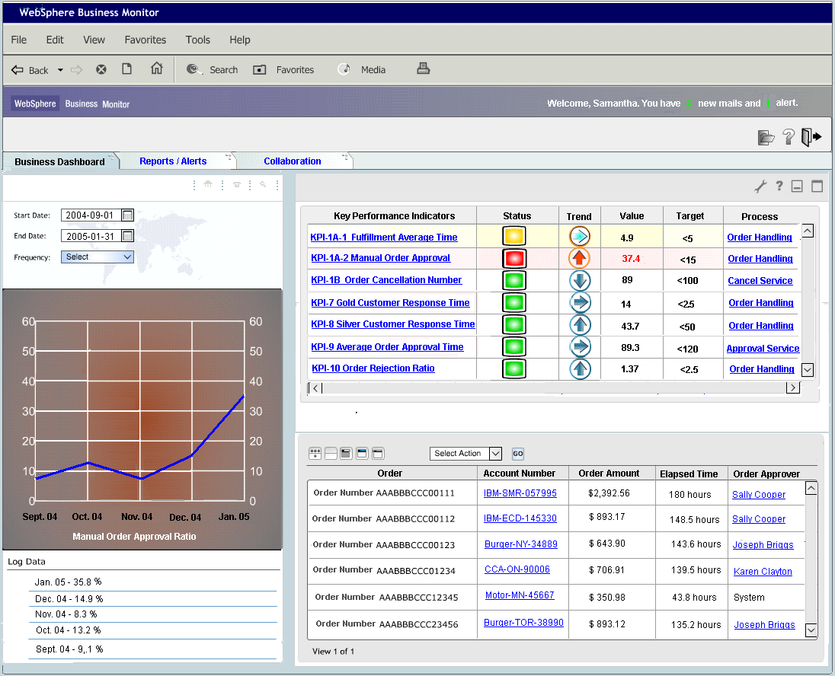
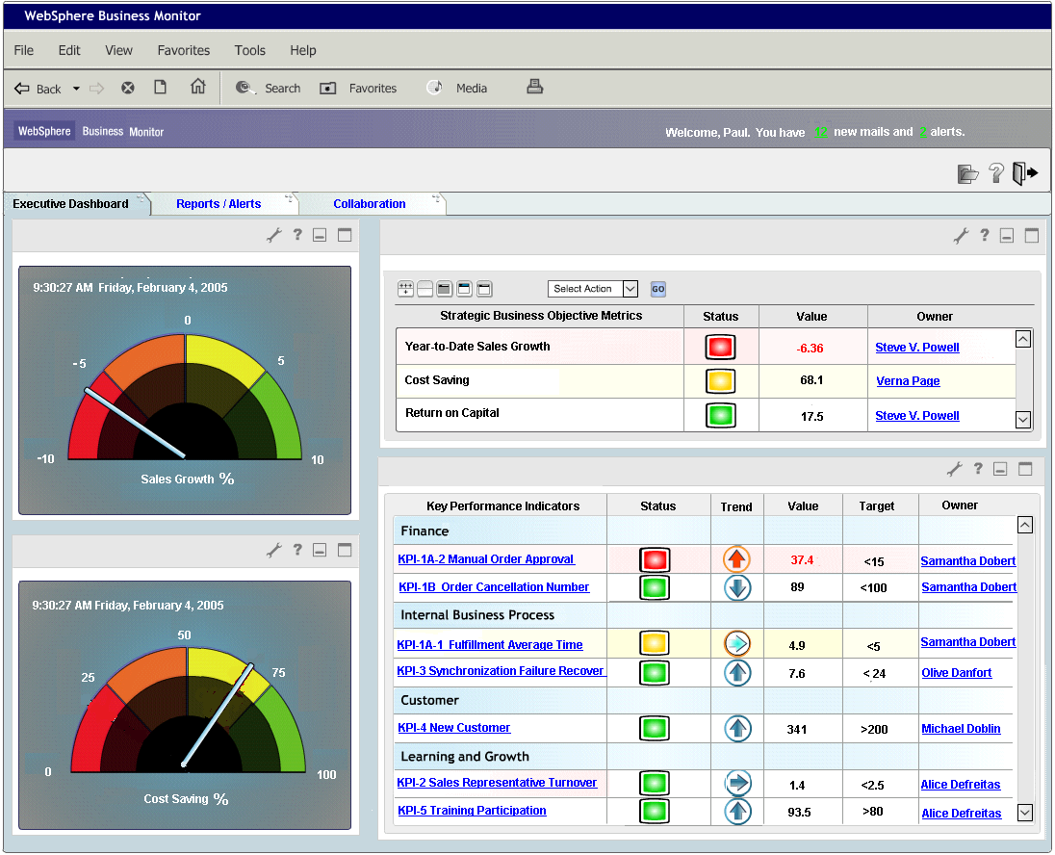
Business Process Monitoring
Report on business performance measured against targets (scorecard)
Share growth and new product revenue
Track business process flow
Status of particular insurance claim
Bottlenecks due to human tasks
Monitor business process metrics
Duration, cost, branch ratios
Business Analysis through aggregation and multidimensional reporting
Total monthly revenue by customer
Notes:
The ability to optimize business processes is a key aspect to overall SOA management. Misalignment of business processes or a bottleneck in workflow can jeopardize goals crucial to the success of your business. With greater visibility into your business processes and events, you can more easily identify—and resolve—potential problems before they pose a threat to your business goals.
For example, you need the ability to report on business performance measured against your targets, track business process flow, monitor business process metrics, and analyze your business through aggregation and multi-dimensional reporting.
You’ll be able to monitor your processes from end to end to show an up-to-the-minute view of your enterprise performance.

Slide 7
Requirements for SOA Management
Manage Transaction Performance: Measure transaction response times to discover bottlenecks, isolate infrastructure
Channel
B2B
Consumers
Service Consumer
Business Process
Composition; choreography;
business state machines
QoS Layer (Security, Management &
Monitoring Infrastructure Services)
Data Architecture (meta-data) &
Business Intelligence
Integration (Enterprise Service Bus)
Governance
Services
atomic and composite
Service Components
Service Provider
Operational Systems
Packaged
Application
Custom
Application
OO
Application
Atomic Service
Composite Service
Registry
Notes:
The second management area that we will discuss is managing Service Relationships, which includes:
Understanding how services relate to each other and to the IT infrastructure and business process layers
Controlling the message flow in the service environment through management mediations like log, filter, and route
Centralizing services management policy
Setting business-related IT goals

Slide 8
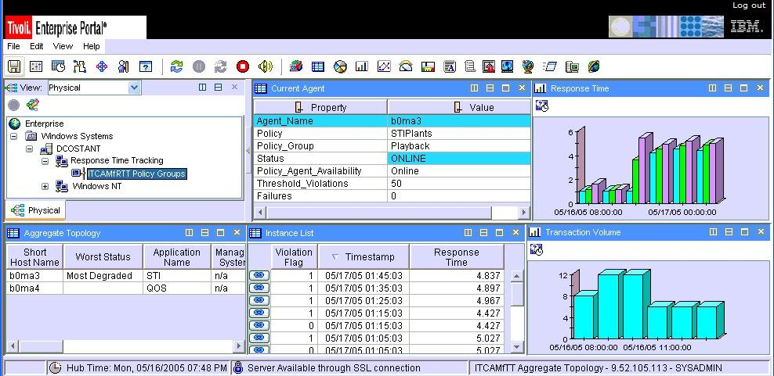
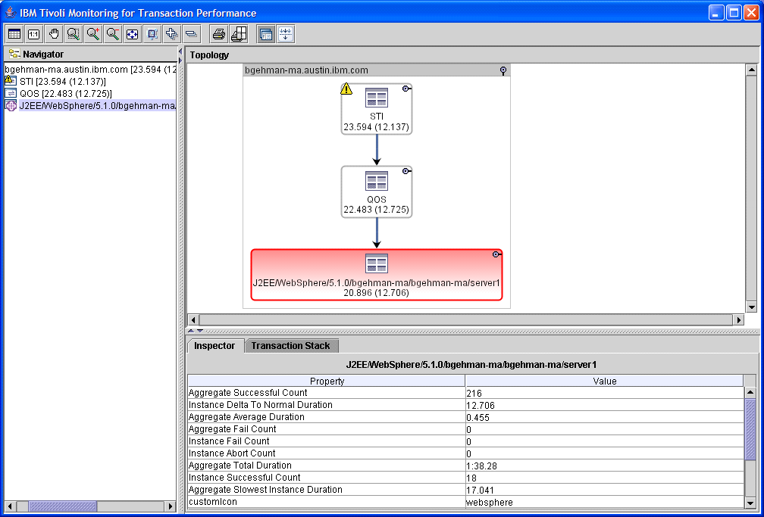
Manage Transaction Performance Provide Key Response Time Metrics Across Platforms
Customers find it very difficult to identify and isolate performance bottlenecks in composite applications that span technology and platform boundaries
Need to provide performance instrumentation that is lightweight and can be dynamically configured to identify problems before customers call
ARM-based instrumentation is the industry standard that can be leveraged to isolate the problem
ITCAM for Response Time Tracking
ITCAM for WebSphere
Notes:
Typically in complex web application environment, it takes too long to identify and isolate performance bottlenecks. You need the ability to quickly identify where and with which component the bottleneck or failure occurred via graphical topology for fast resolution and recovery.

Slide 9
Requirements for SOA Management
Services Management: Discover, monitor, secure and manage services to meet SLAs
Channel
B2B
Consumers
Service Consumer
Business Process
Composition; choreography;
business state machines
QoS Layer (Security, Management &
Monitoring Infrastructure Services)
Data Architecture (meta-data) &
Business Intelligence
Integration (Enterprise Service Bus)
Governance
Services
atomic and composite
Service Components
Service Provider
Operational Systems
Packaged
Application
Custom
Application
OO
Application
Atomic Service
Composite Service
Registry
Notes:
The second management area that we will discuss is managing Service Relationships, which includes:
Understanding how services relate to each other and to the IT infrastructure and business process layers
Controlling the message flow in the service environment through management mediations like log, filter, and route
Centralizing services management policy
Setting business-related IT goals

Slide 10

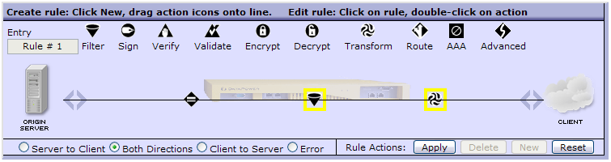

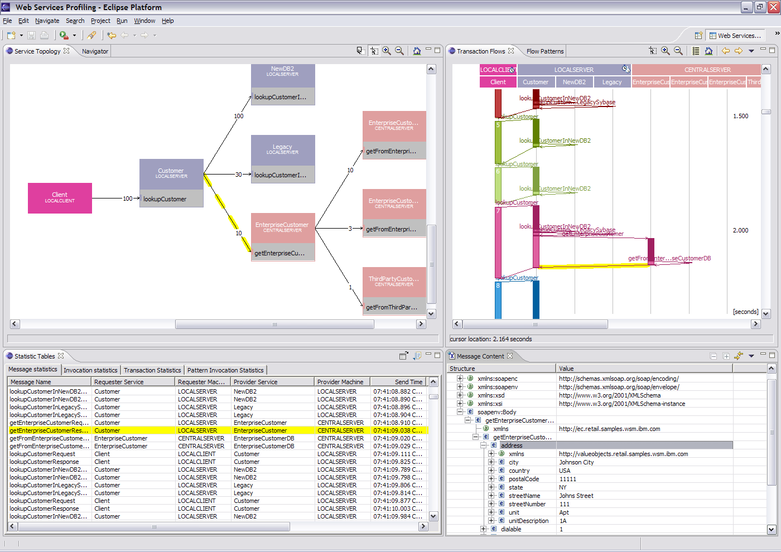
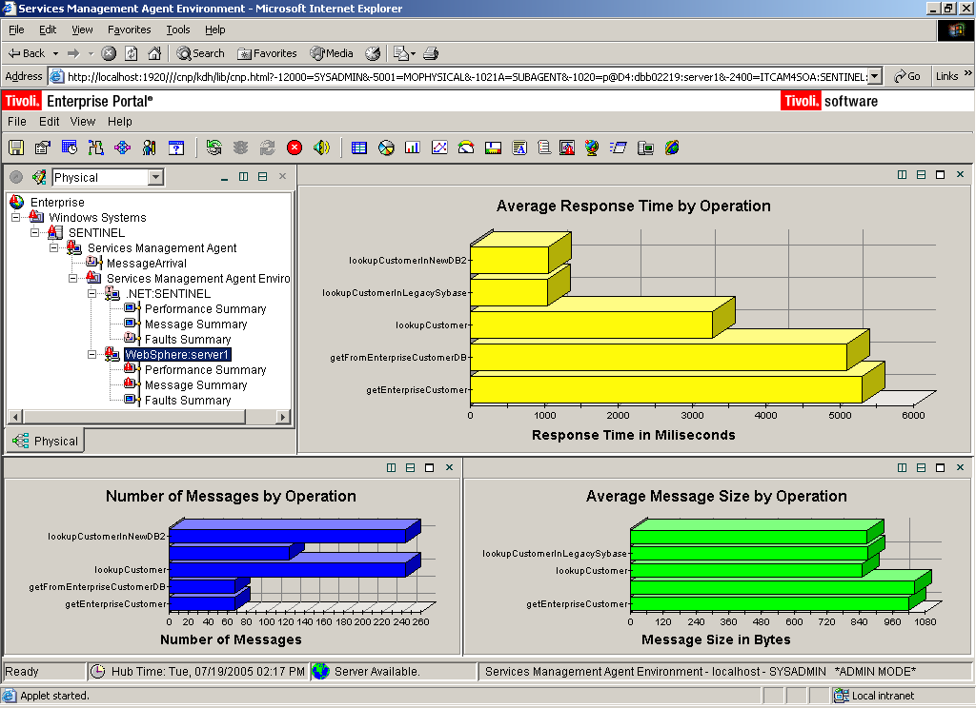
Services Management Lifecycle Support for Web Services
To ensure service levels conform to agreed upon specifications, you need:
Views and analysis of Web service interactions for IT Operations to quickly identify source of errors, and take corrective action through situations, workflow and mediations
Detailed views of operational SOAP/XML message content, flow patterns and topology for Web services experts and support teams
Highly performing and flexible enforcement points
IT Operations
“Don’t give me another console”
Web Services Expert
“Show me the service details!”

Slide 11
Requirements for SOA Management
Manage the Infrastructure: Deep dives into specific resources
Channel
B2B
Consumers
Service Consumer
Business Process
Composition; choreography;
business state machines
QoS Layer (Security, Management &
Monitoring Infrastructure Services)
Data Architecture (meta-data) &
Business Intelligence
Integration (Enterprise Service Bus)
Governance
Services
atomic and composite
Service Components
Service Provider
Operational Systems
Packaged
Application
Custom
Application
OO
Application
Atomic Service
Composite Service
Registry
Notes:
The second management area that we will discuss is managing Service Relationships, which includes:
Understanding how services relate to each other and to the IT infrastructure and business process layers
Controlling the message flow in the service environment through management mediations like log, filter, and route
Centralizing services management policy
Setting business-related IT goals

Slide 12
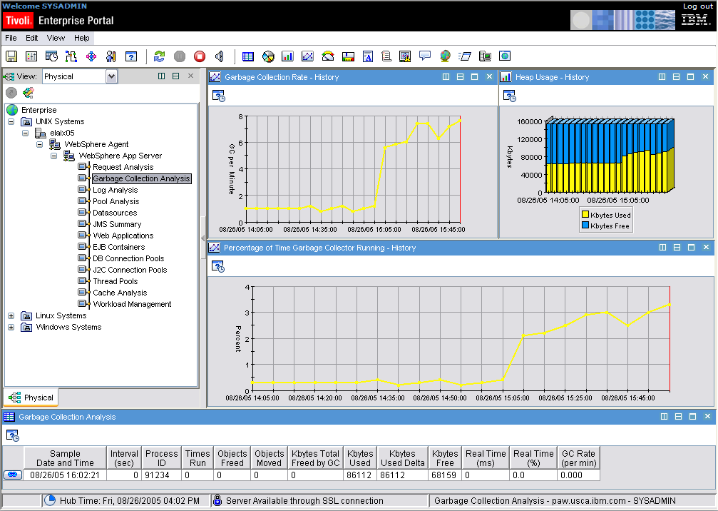
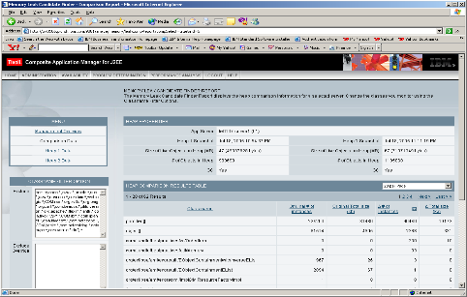
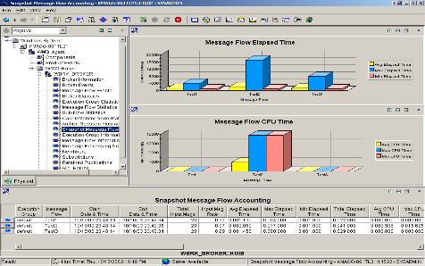
Manage Supporting Middleware Comprehensive Deep-dive Monitoring
Identify and quickly correct applications that are down or performing slowly
Need to provide comprehensive in-flight transaction display that includes the name of the hung class/method
Introspect messaging and brokering subsystem for real-time metrics and historical data analysis
This can significantly improve the performance and availability of J2EE applications by reducing problem identification and resolution time
IT Operations
Subject Matter Expert
J2EE Applications
Messaging Infrastructure

Slide 13
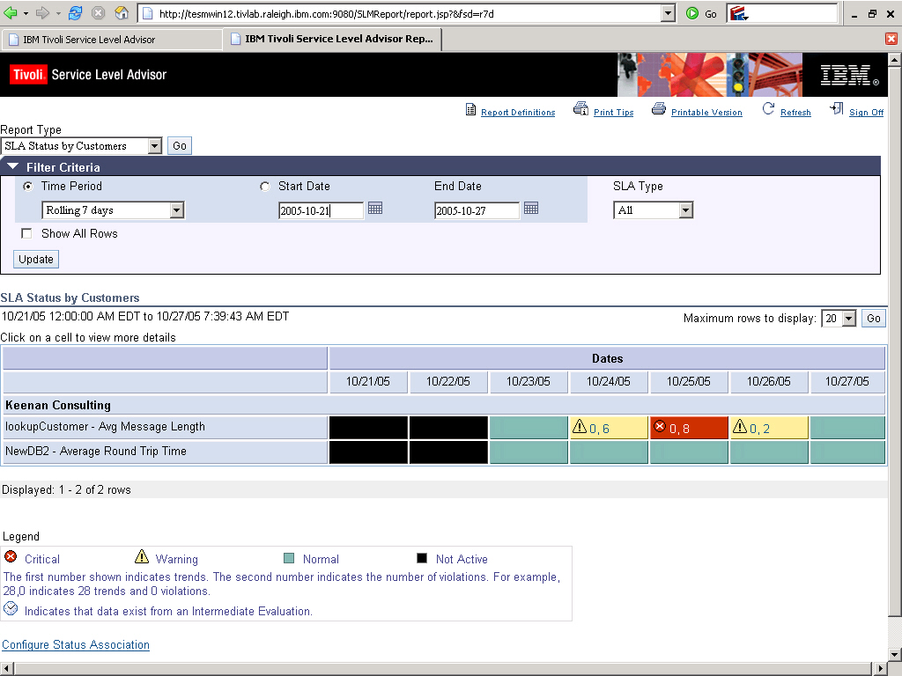
Manage Service Levels Enterprise-wide Reporting on Service Level Compliance
Need to define reports on a customer basis
Report on compliance to service levels and service level agreements
Represent all aspects of service level performance, from business process layer to IT infrastructure
Perform trending analysis to predict outages

Slide 14
Enterprise Service Bus and SOA Management
Management tools naturally target ESBs as enforcement endpoints:
NEW Check
Traveler
Service
Travel
Reservation
Process
Check Credit
Service
Book Flight
Service
To perform Routing of messages based on system capacity, Quality of Service, and SLAs
Leverage Conversion and Transformation capabilities to comply with policy
Centralize Handling of IT events related to Services
Service Management Leveraging the ESB
Enterprise Service Bus
Hotel
Availability
Service
Flight
Availability
Service
Book Hotel
Service
Book Car
Service
NEW Flight
Availability
Service
OLD Flight
Availability
Service

